Slide 1


Physical Education
Our school is working towards the Active School Flag.
This is a record of the work that we have undertaken.
Notes:
Please read the GUIDELINES: ASF Template Slideshows document in the ASF Members Area on www.activeschoolflag.ie (Website Showcase section)

Slide 2
PE Timetable
www.activeschoolflag.ie
Notes:
Please provide confirm/provide that all classes are timetabled for 60 minutes (ore more) of PE every week.

Slide 3
PE Yearly Scheme
Month | Duration (Varies by Year) | Strand | Fundamental Movement Skills
September/October | 8 weeks approximately | Athletics/Aquatics | * Walking *Hopping
November/December | 8 weeks approximately | Games/Aquatics | *Dodging * Striking with hand
January/February | 7 weeks approximately | Dance/Aquatics | *Balancing *Side stepping
March/April | 7 weeks approximately | Gymnastics/Aquatics | *Landing *Jumping for height
May/June | 8 weeks approximately | Outdoor and Adventure/Aquatics | *Hopping *Jumping for distance
www.activeschoolflag.ie
Notes:
Please provide evidence that Aquatics forms part of your school PE programme. If your school cannot bring children to swimming lessons you should delete this slide.

Slide 4
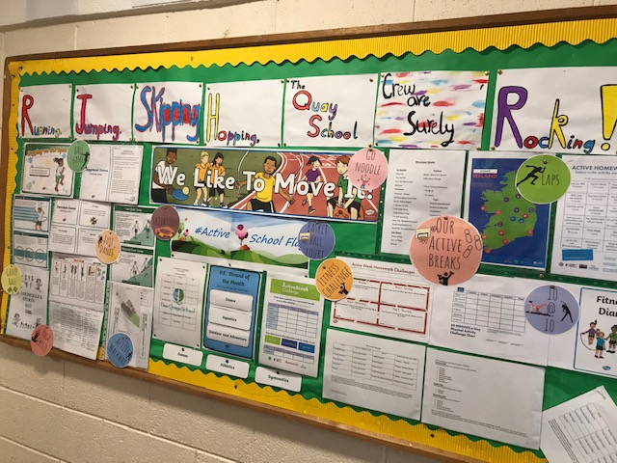
Active School Wall
www.activeschoolflag.ie
Notes:
Please provide evidence that Athletics forms part of your PE programme

Slide 5
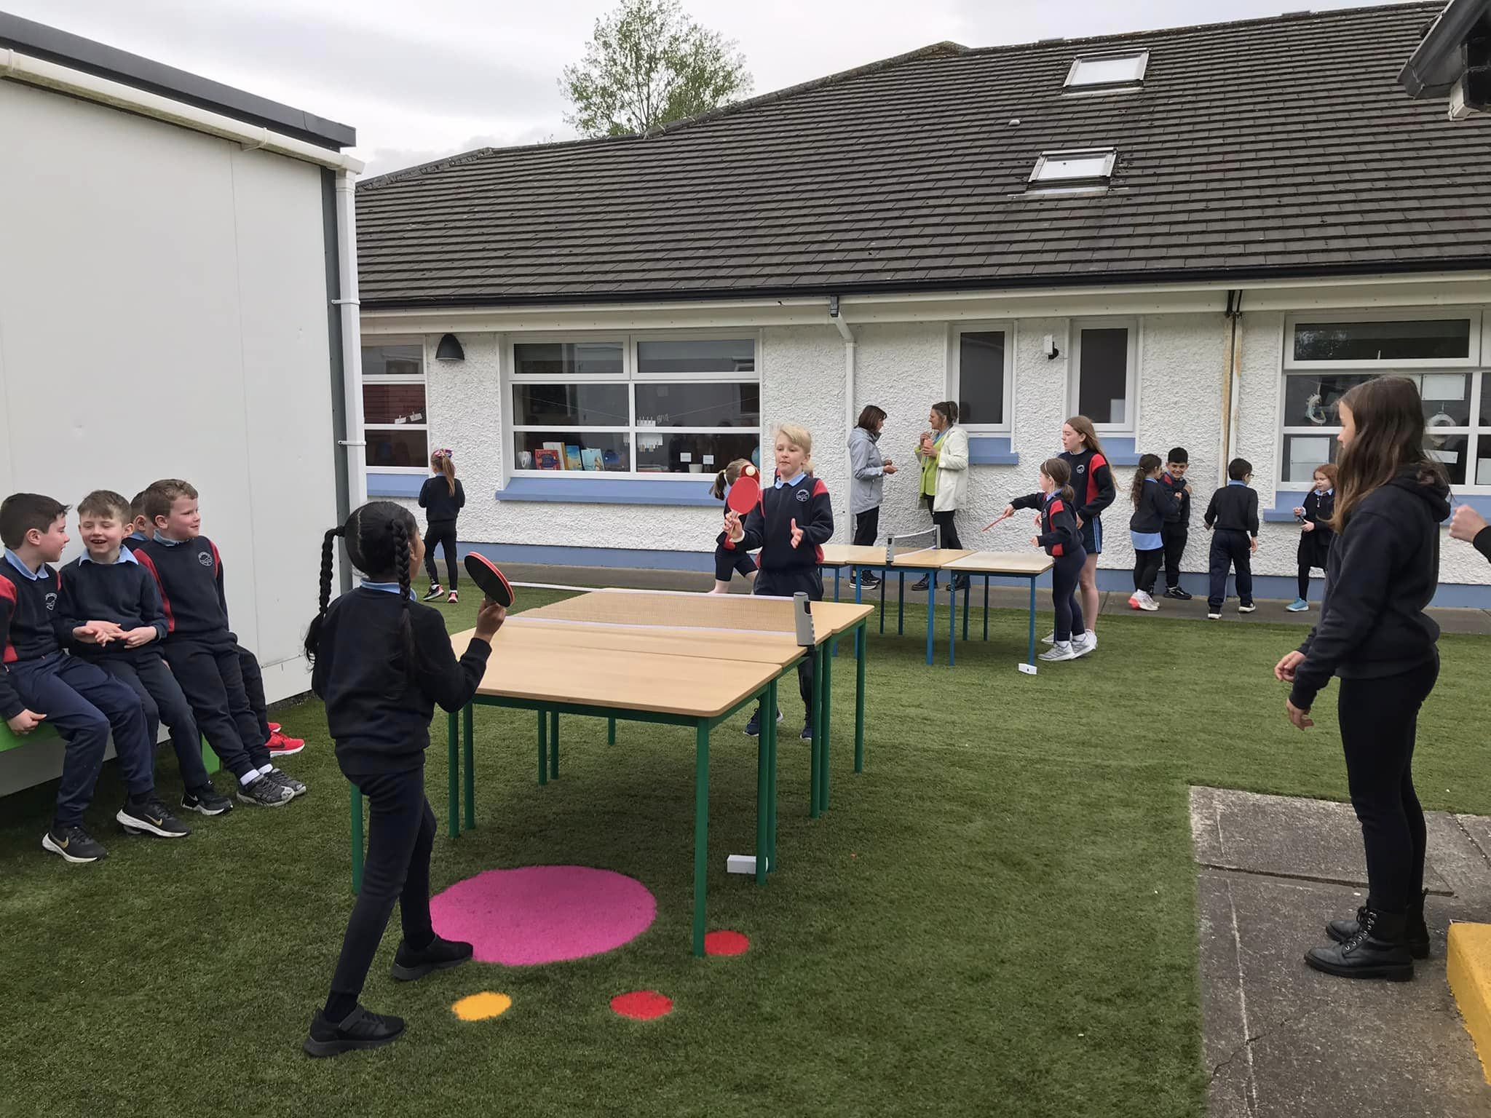
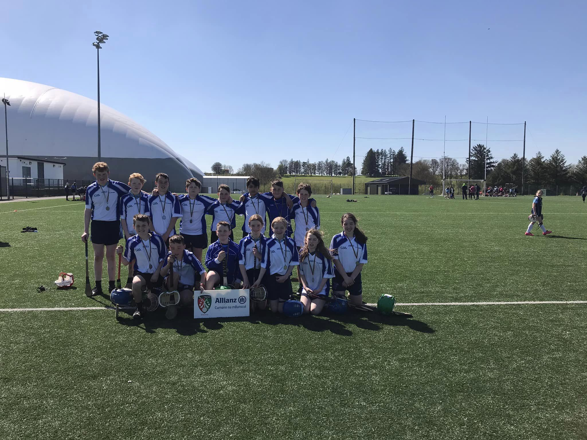
Games form part of our PE programme
www.activeschoolflag.ie
Notes:
Please provide evidence that Games forms part of your PE programme

Slide 6
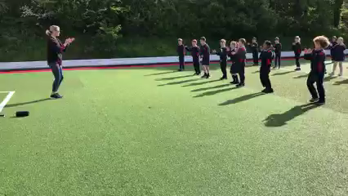
Gymnastics forms part of our PE programme
www.activeschoolflag.ie
Notes:
Please provide evidence that Gymnastics forms part of your PE programme

Slide 7
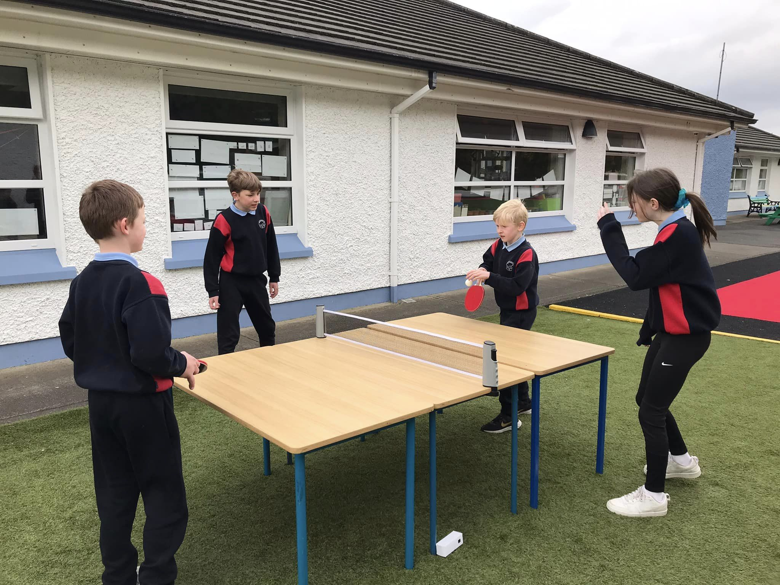
Outdoor and Adventure forms part of our PE programme
www.activeschoolflag.ie
Notes:
Please provide evidence that Outdoor and Adventure forms part of your PE programme

Slide 8
This Year’s
Priority PE Strand:
Athletics
PE Yearly Schedule
Month | Duration (Varies by Year) | Strand | Fundamental Movement Skills
September/October | 8 weeks approximately | Athletics/Aquatics | * Walking *Hopping
November/December | 8 weeks approximately | Games/Aquatics | *Dodging * Striking with hand
January/February | 7 weeks approximately | Dance/Aquatics | *Balancing *Side stepping
March/April | 7 weeks approximately | Gymnastics/Aquatics | *Landing *Jumping for height
May/June | 8 weeks approximately | Outdoor and Adventure/Aquatics | *Hopping *Jumping for distance
St Colmcille’s NS PE Yearly Schedule
www.activeschoolflag.ie
Notes:
Please write the name of the priority PE strand that your school worked on in the box provided and provide evidence of the work undertaken.
Please Note – FMS development work should take place at all class levels.

Slide 9
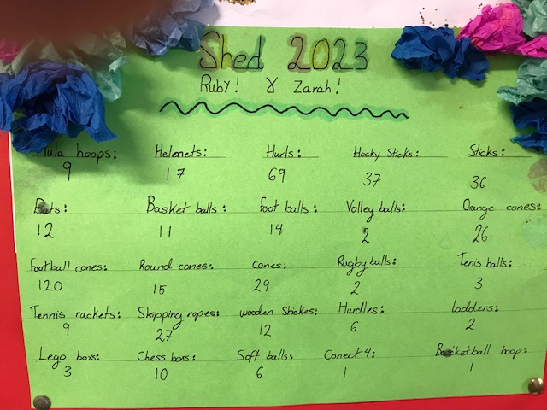
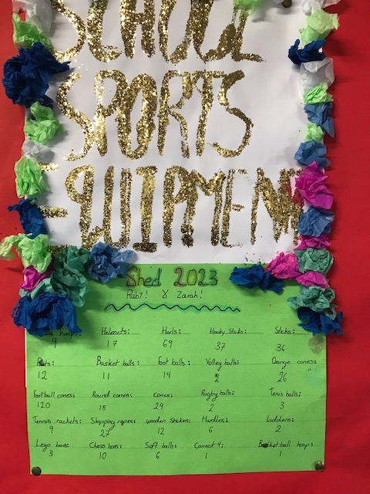
Organised and Labelled PE Equipment
www.activeschoolflag.ie
Notes:
Please provide evidence that PE equipment is organized, labelled and easily accessible.

Slide 10
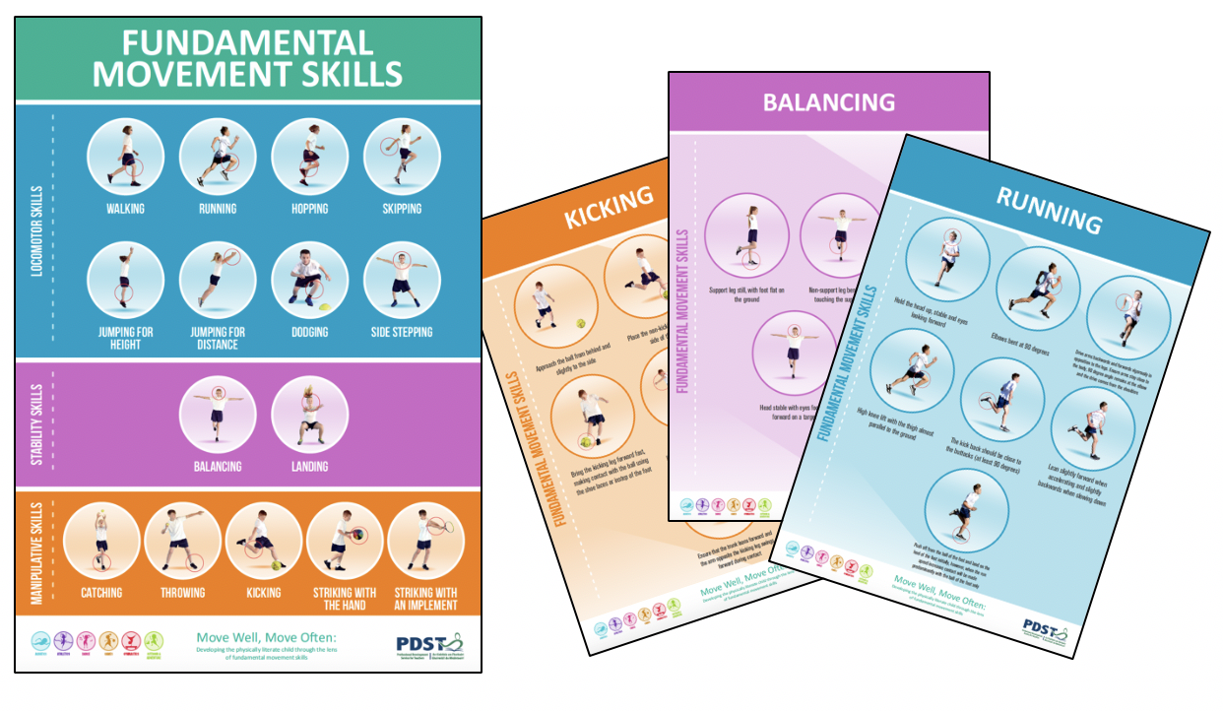
Fundamental Movement Skills
All teachers, using the Move Well, Move Often resource,
prioritise 4 or more fundamental movement skills (FMS) for
further development within their PE programme every year.
Notes:
The PDST PE ‘Move Well, Move Often’ programme supports schools to promote Fundamental Movement Skills. Please Note – FMS development work should take place at all class levels.
Find Out More: https://www.scoilnet.ie/pdst/physlit/

Slide 11
Priority FMS 1
This year we are working on the FMS of:
Locomotor Skill - Running
What are Fundamental Movement Skills?
FMS are the basic building blocks of movement and a core element of physical literacy, because enhanced movement competence enables pupils to participate in a wide range of physical activities and settings, for a variety of intensities and durations. It is only when these skills are mastered that a child can go on to develop specialised movement skills, which will allow them to reach their potential in sports – specific endeavours.
www.activeschoolflag.ie
Notes:
This criterion applies for RENEWAL schools. Please write the name of the 1st FMS that your school worked on in the box provided and photographic evidence of the work undertaken by your school.
New applicant schools can delete this slide.

