Slide 1


Physical Activity
Our school is working towards the Active School Flag.
This is a record of the work that we have undertaken.
Notes:
Please read the GUIDELINES: ASF Template Slideshows document in the ASF Members Area on www.activeschoolflag.ie (Website Showcase section)

Slide 2
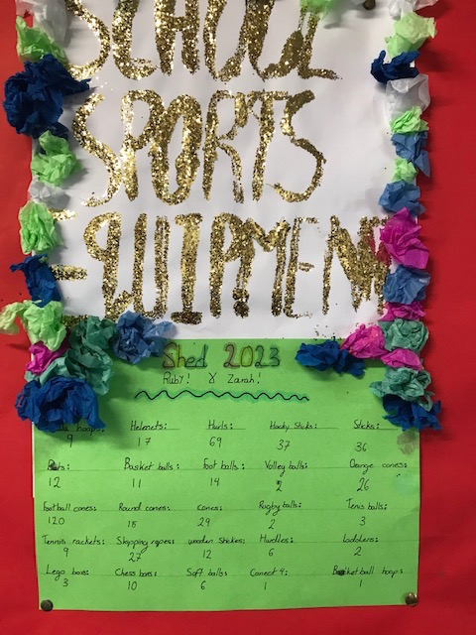
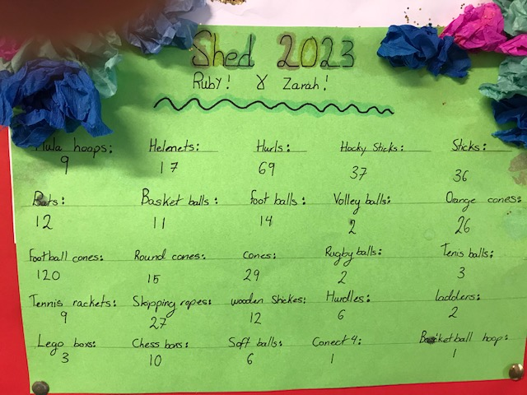
Playground Equipment
www.activeschoolflag.ie
Notes:
Please provide evidence of how playground equipment is used to promote physical activity during break-times.

Slide 3
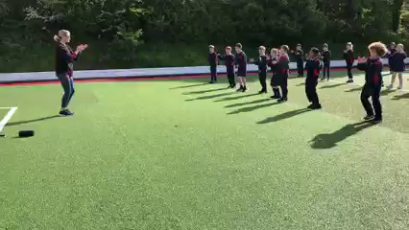
Music in the Yard
www.activeschoolflag.ie
Notes:
Many schools use music in the yard to generate physical activity. If your school doesn’t you can delete this slide.

Slide 4
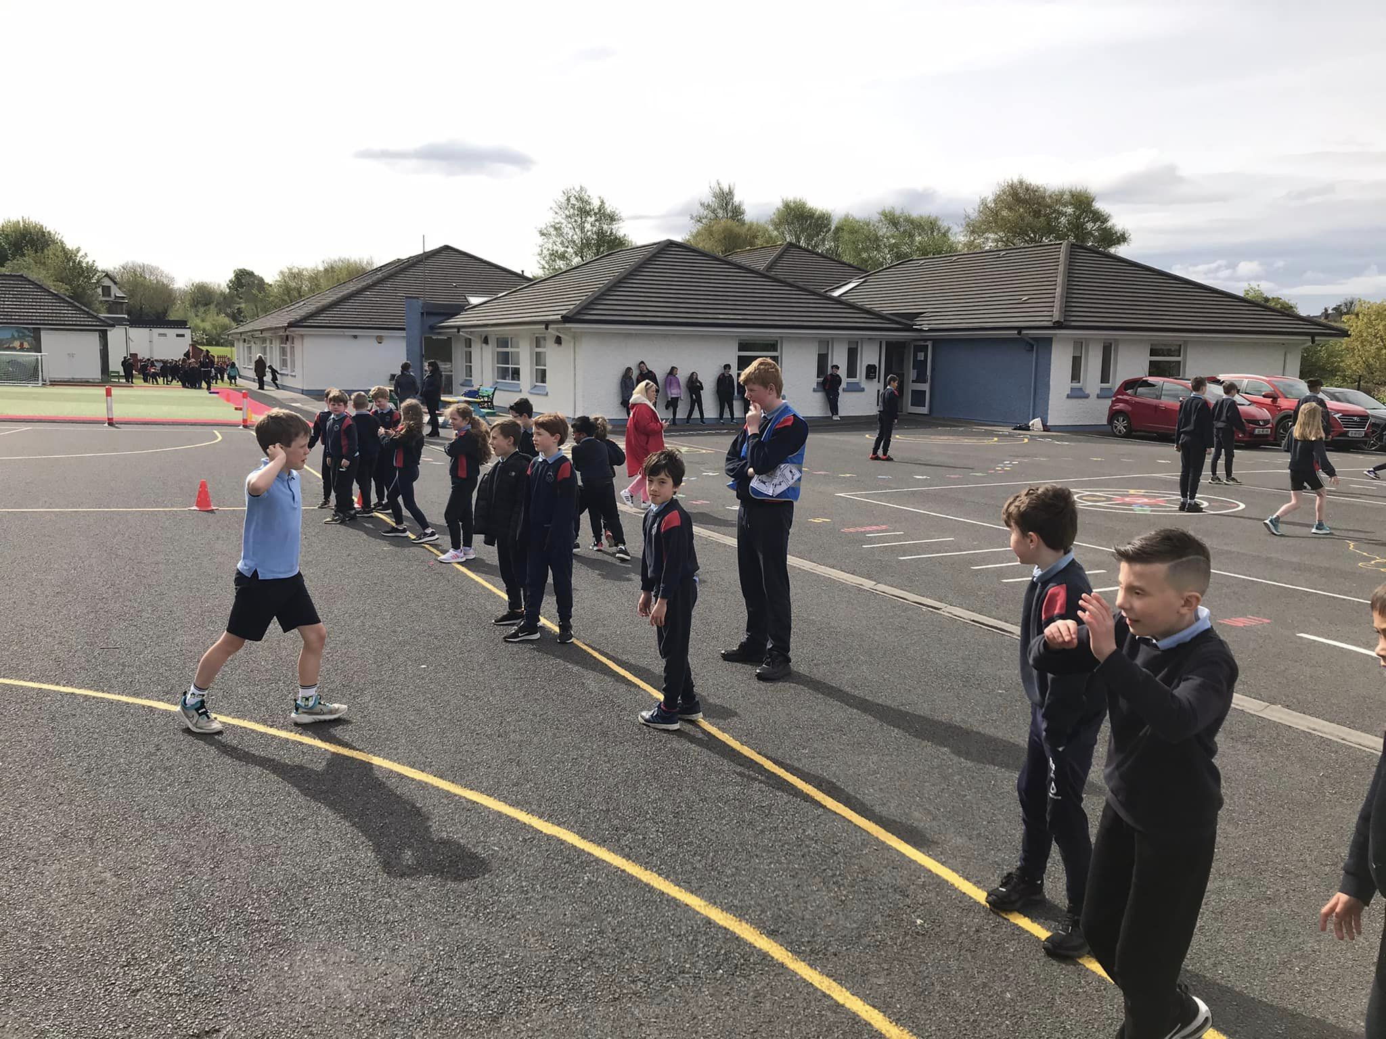
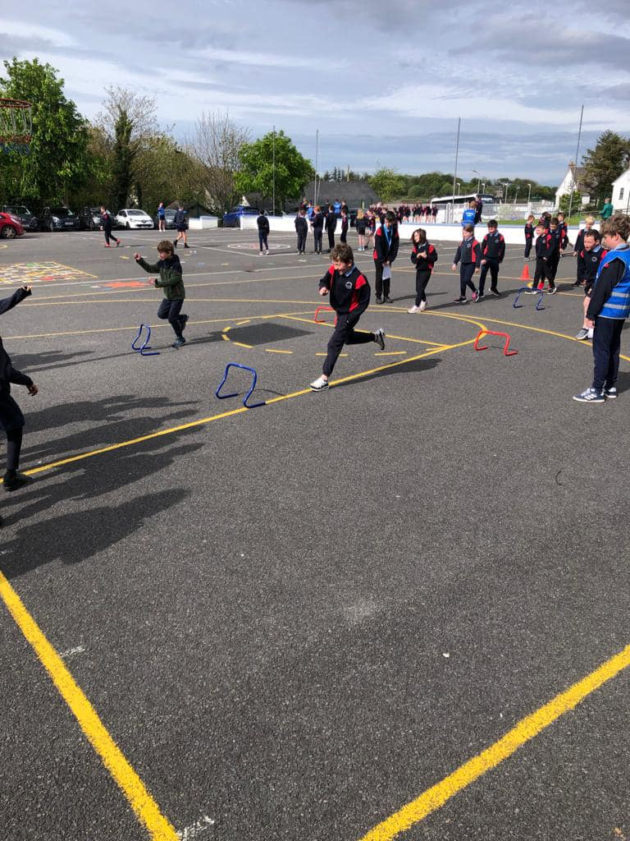
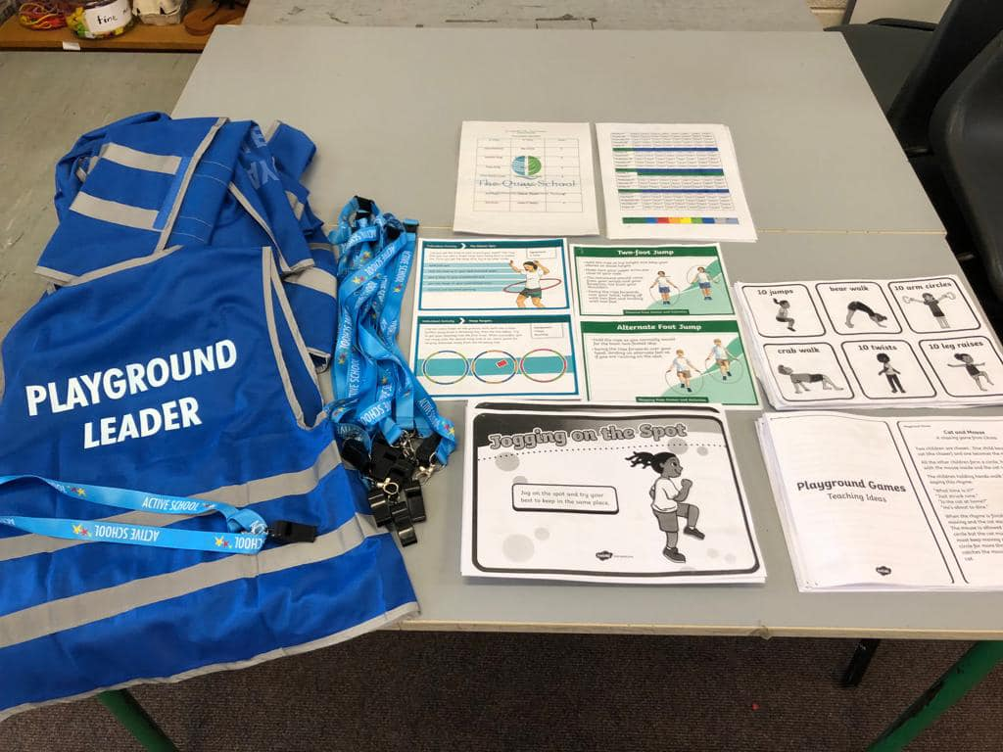
Playground Leaders
www.activeschoolflag.ie
Notes:
Please provide evidence of Playground Leaders in action. If this is not possible due to Covid-restrictions please explain this in your application form and delete this slide.

Slide 5

Our Active School Walkway is used to:
www.activeschoolflag.ie
Notes:
WALKWAY signage is provided to registered schools that attend the Walkway webinar scheduled every spring.

Slide 6
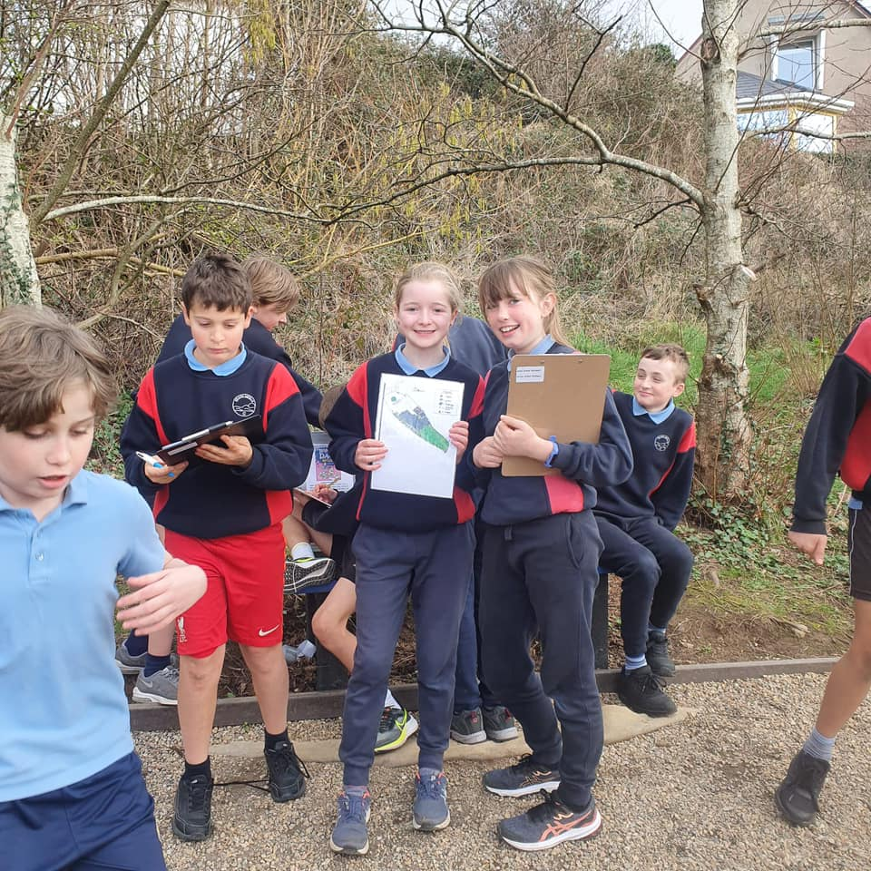
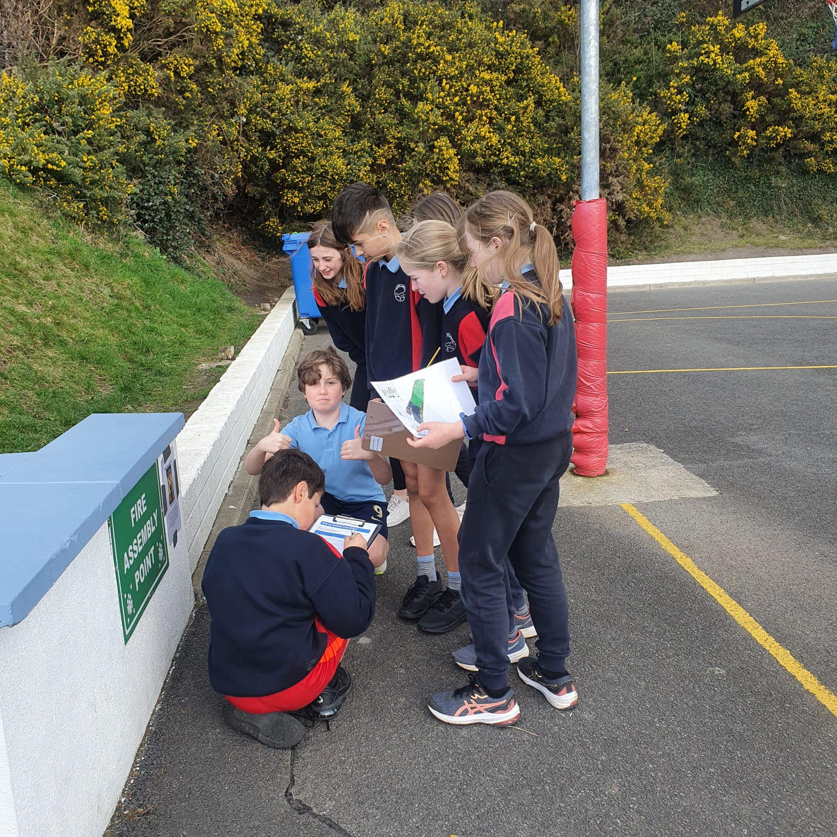
Our WALKWAY Route
www.activeschoolflag.ie
Notes:
Please provide evidence of the signposted Walkway route on your school grounds

Slide 7
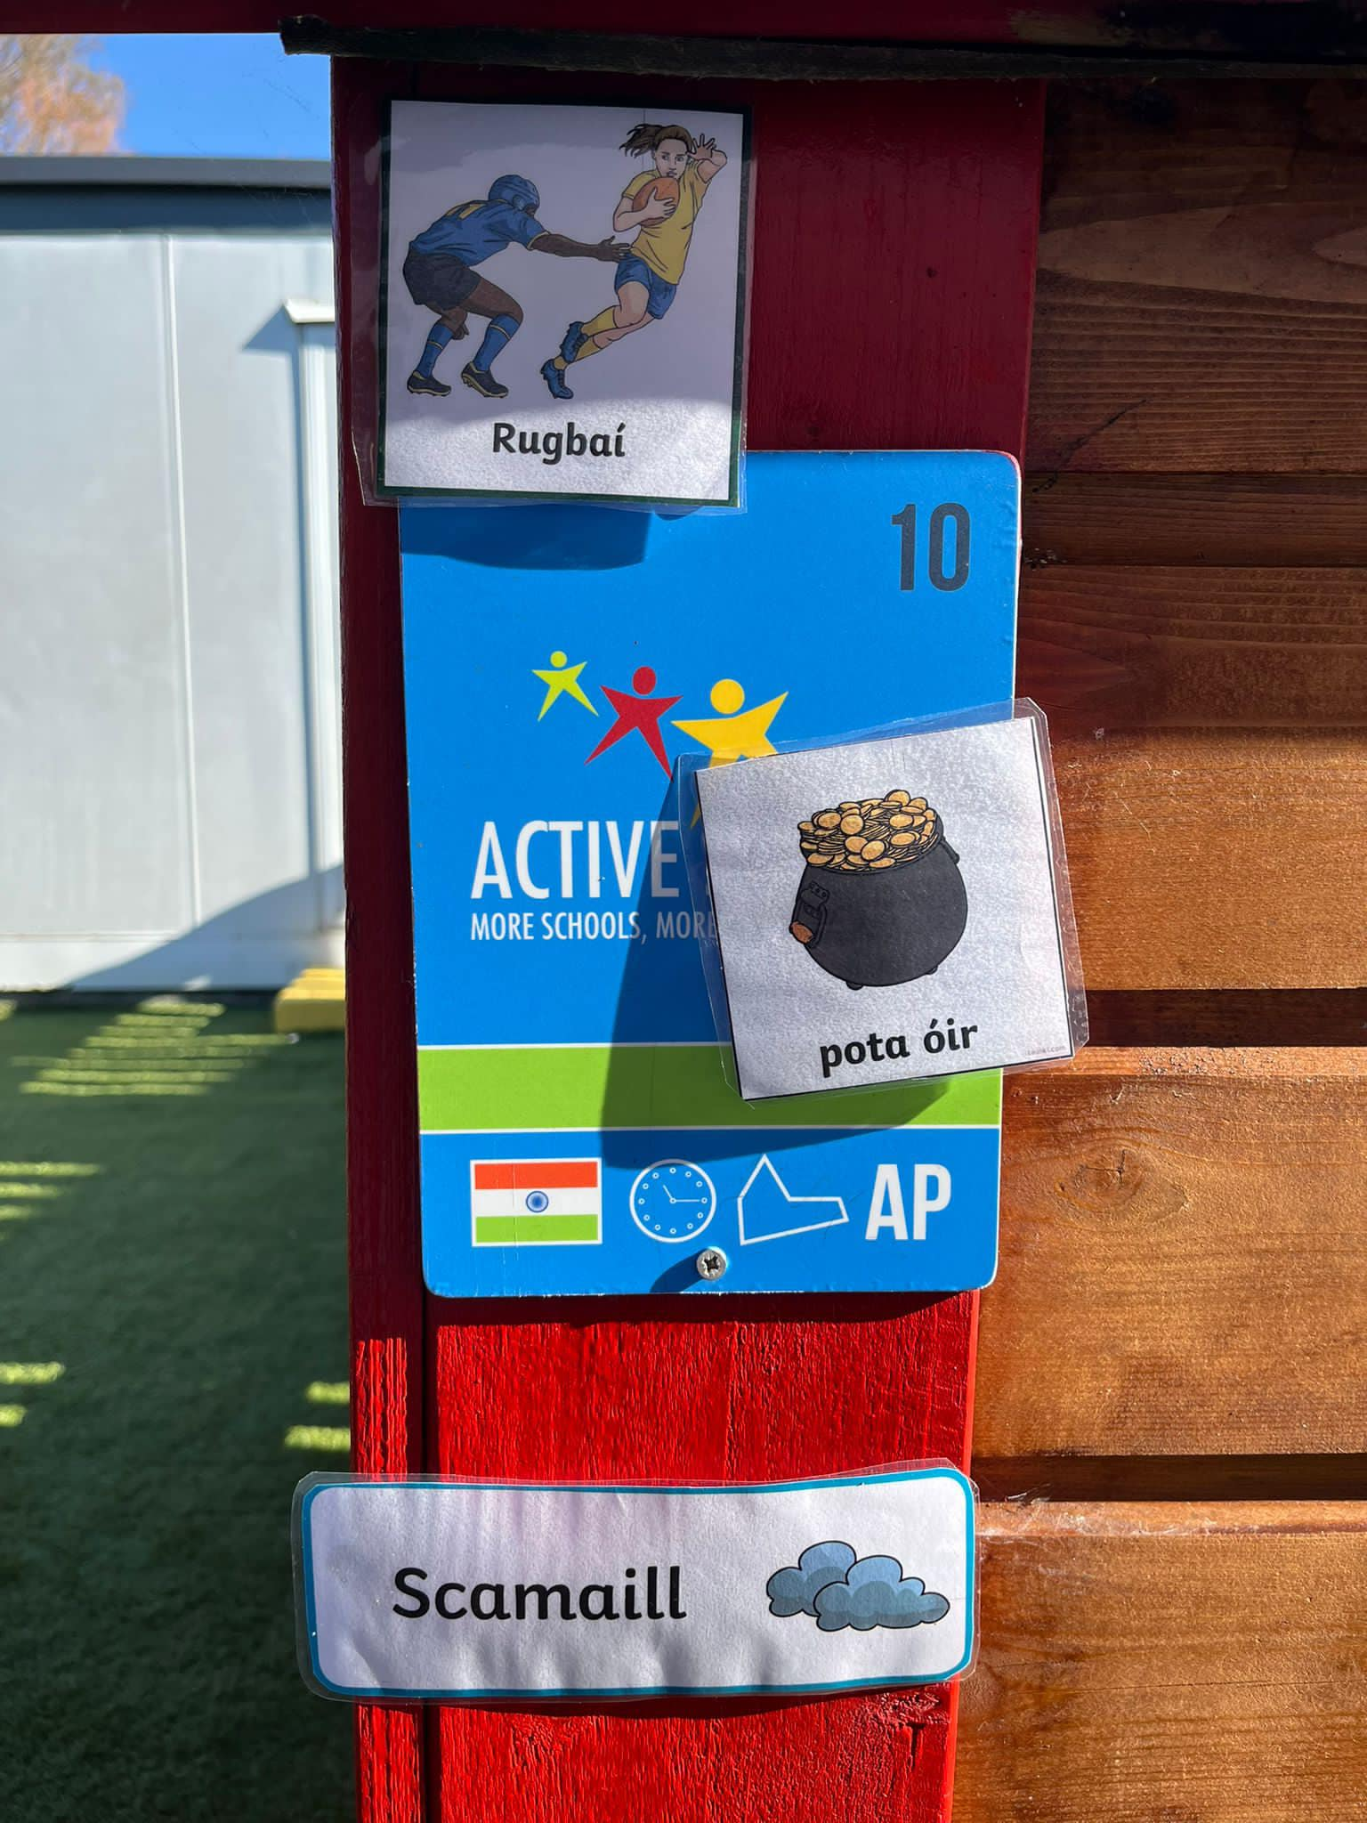
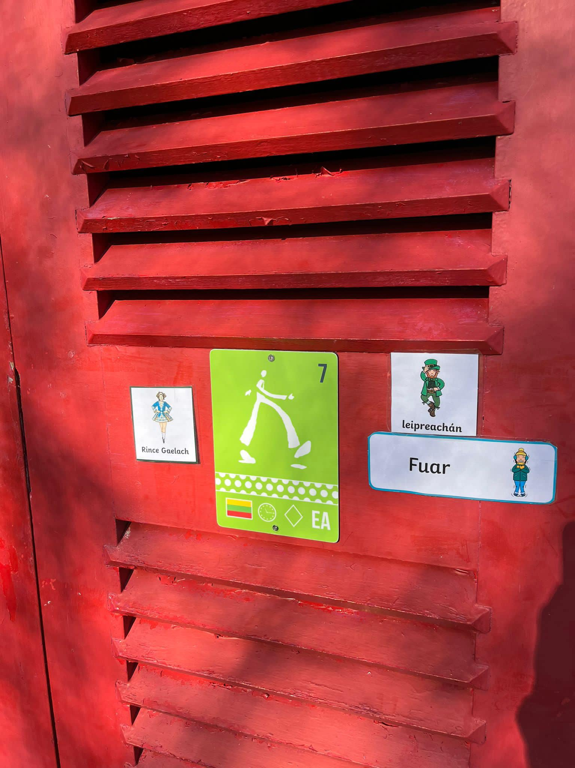
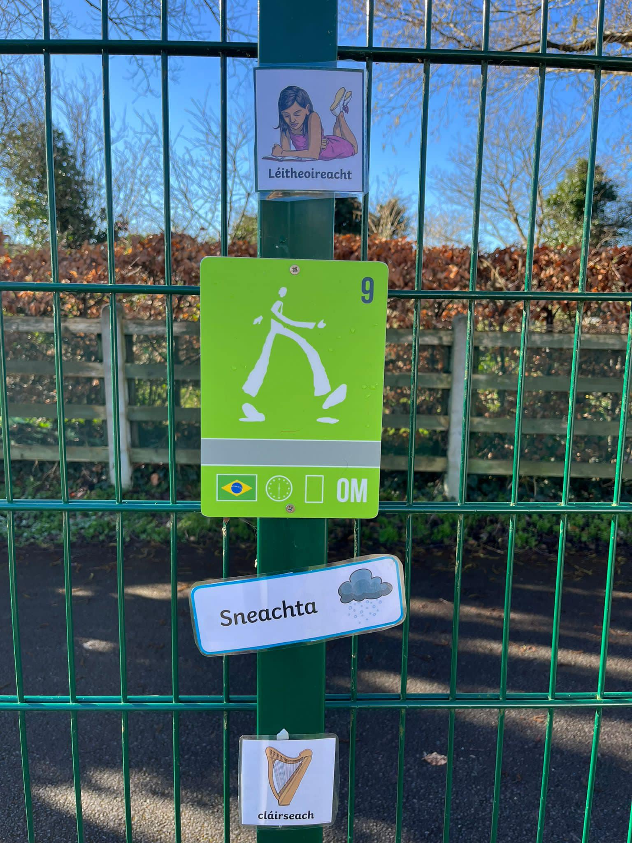
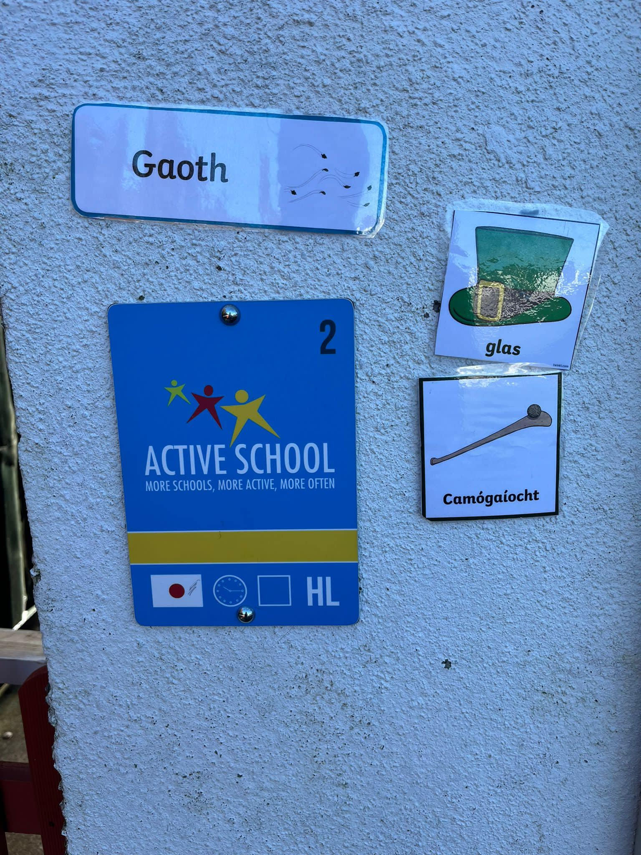
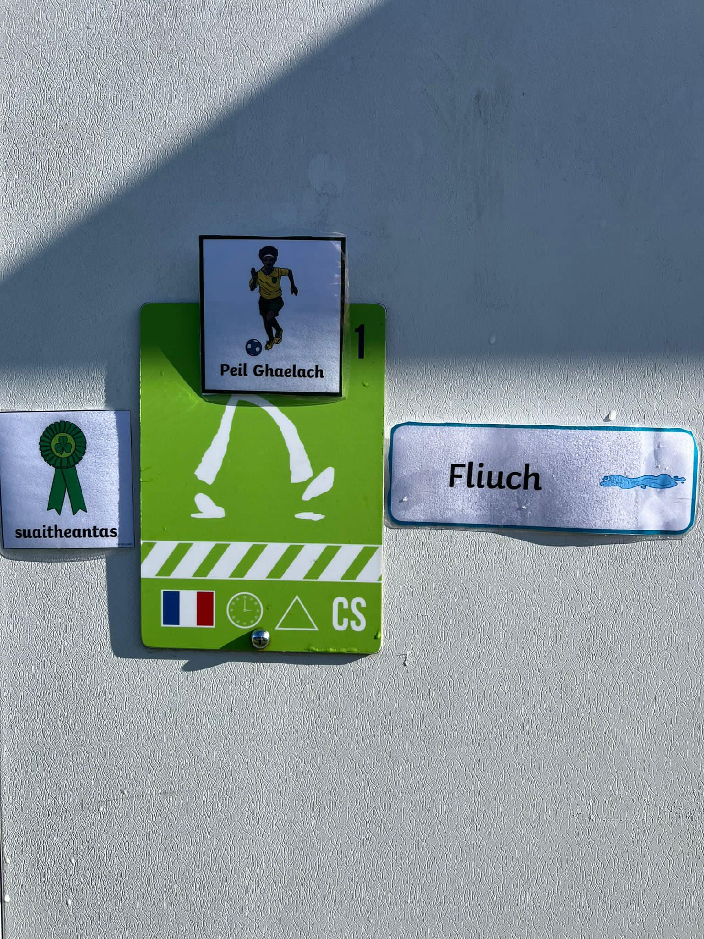
WALKWAY Activities
www.activeschoolflag.ie
Notes:
Please provide evidence of your Walkway route and the Walkway challenges in use.

Slide 8


Active Breaks Challenge
Dates:
Insert Dates
All classes participated.
Challenge lasted 4 weeks.
Variety in active breaks.
Notes:
This is a KEY part of the ASF process and should be organized as a whole of school activity.
Please insert the dates that your school ran this challenge in the box provided at the top of this page

Slide 9
Active Breaks: Juniors
www.activeschoolflag.ie
Notes:
Please provide evidence of junior classes participating in this challenge

Slide 10
Active Breaks: Seniors
www.activeschoolflag.ie
Notes:
Please provide evidence of senior classes participating in this challenge

Slide 11


Running Challenge
Dates:
6th to 31st March 2023
All classes participated.
Challenge lasted 4 weeks.
Running promoted in a FUN and inclusive way.
Notes:
This is a KEY part of the ASF process and should be organized as a whole of school activity.
Please insert the dates that your school ran this challenge in the box provided at the top of this page.

Slide 12
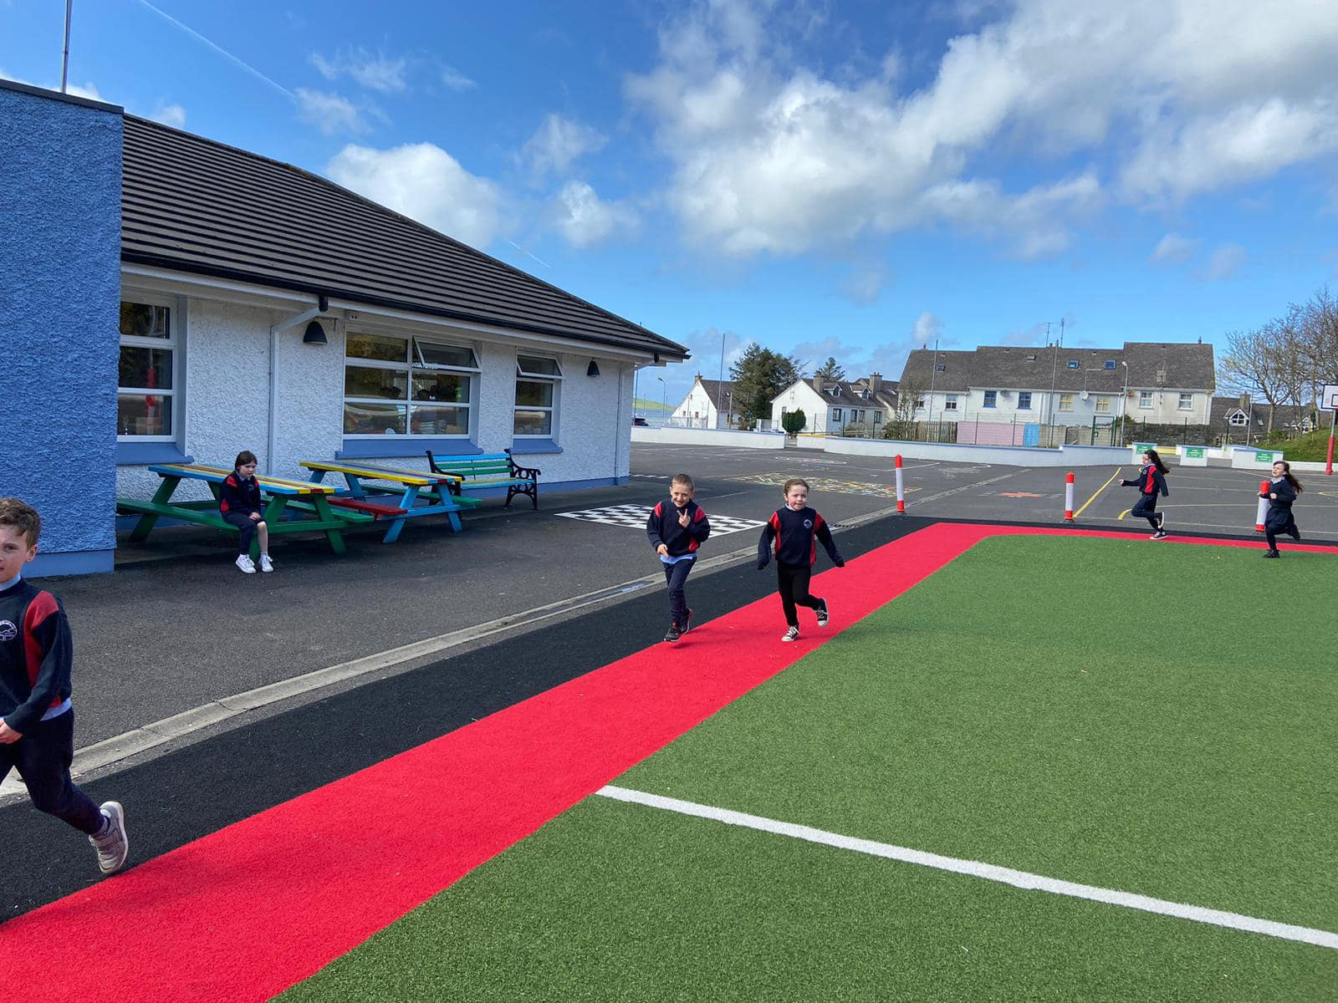
Running Challenge: Juniors
www.activeschoolflag.ie
Notes:
Please provide evidence of junior classes participating in this challenge

Slide 13
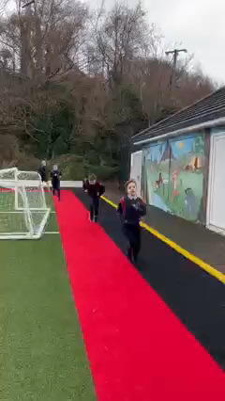
Running Challenge: Seniors
www.activeschoolflag.ie
Notes:
Please provide evidence of senior classes participating in this challenge

Slide 14
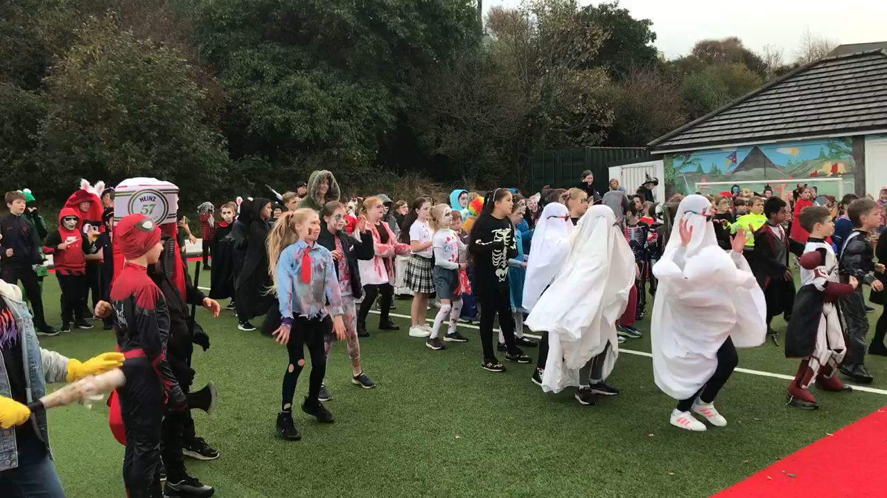
Active Halloween
www.activeschoolflag.ie
Notes:
Please provide evidence of your Active Halloween activities

Slide 15
#FeelGoodFridays
www.activeschoolflag.ie
Notes:
Please provide evidence of your participation in #FeelGoodFridays (if applicable)

Slide 16
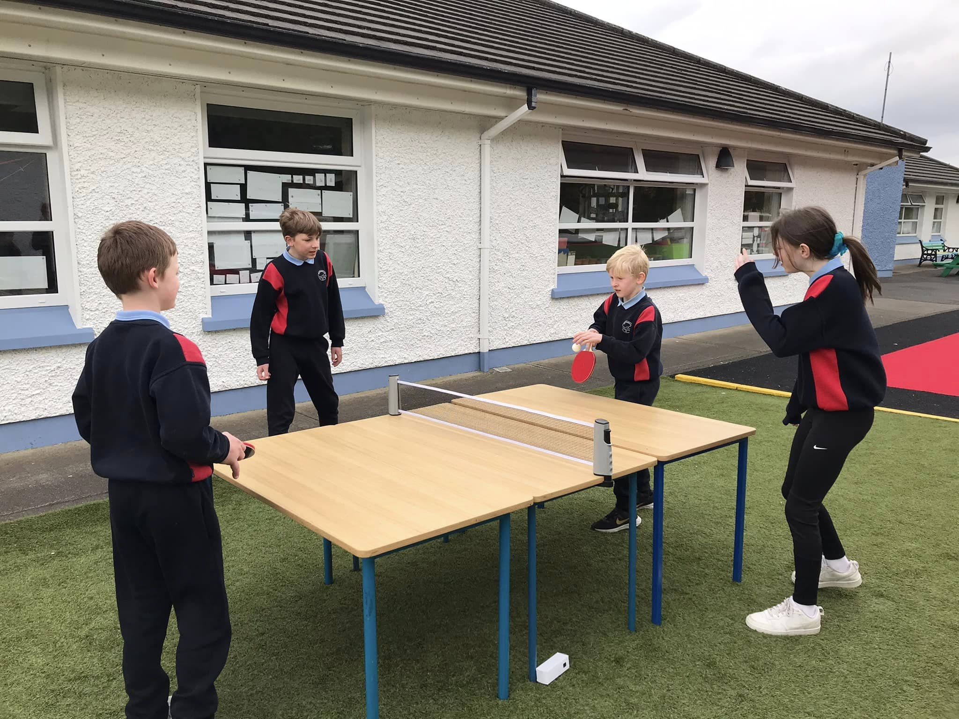
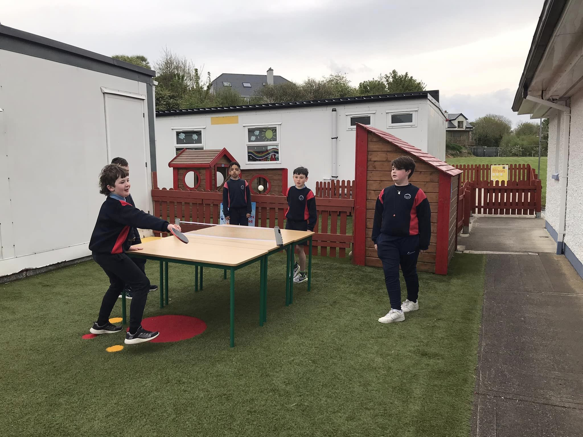
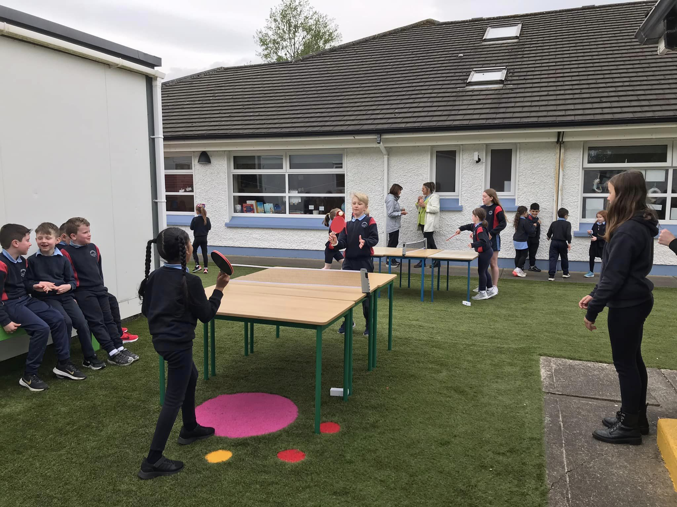
Table Tennis Challenge
www.activeschoolflag.ie
Notes:
This criterion applies to RENEWAL schools. Please provide evidence of the actions that classes agreed, with their teachers, to decrease sedentary time.
New applicant schools can delete this slide.

Slide 17
Table Tennis Takeover Day
Timetable Wednesday 3rd May 2023
Location: Zone 7
Supervision: 6th Class
Time | Class
9:20am | Junior Infants
9:40am | Senior Infants
10:00am | First Class
11:00am | Second Class
11:30am | Third Class
1:00pm | Fourth Class
1.30pm | Fifth Class
2:00pm | Sixth Class
s

