Slide 1


Active School Week
Our school is working towards the Active School Flag.
This is a record of the work that we have undertaken.

Slide 2

Our #ASW Dates:
13th to 17th June 2022
www.activeschoolflag.ie
Notes:
Active School Week (#ASW) is a KEY part of the ASF process and should form part of the annual school calendar. Please insert the dates of your most recent #ASW in the box provided,

Slide 3
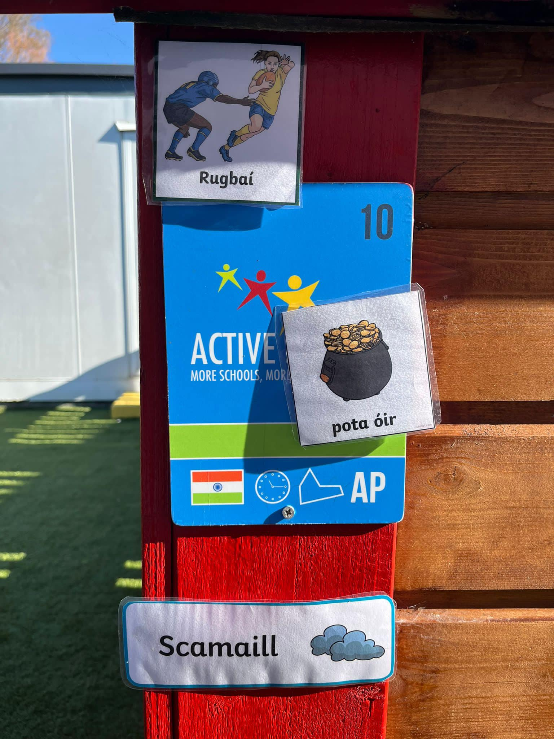
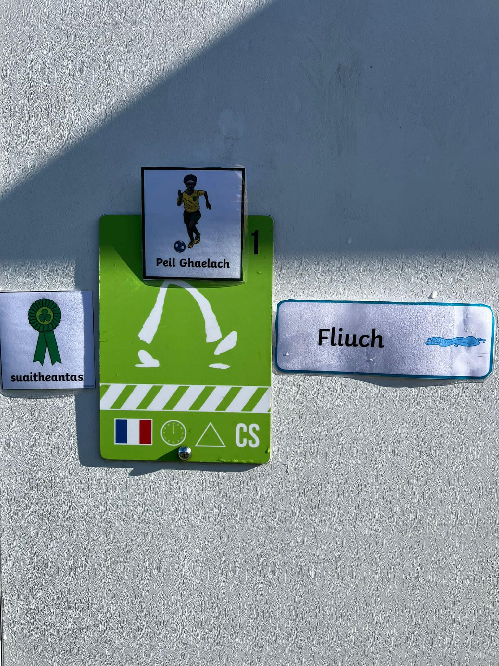
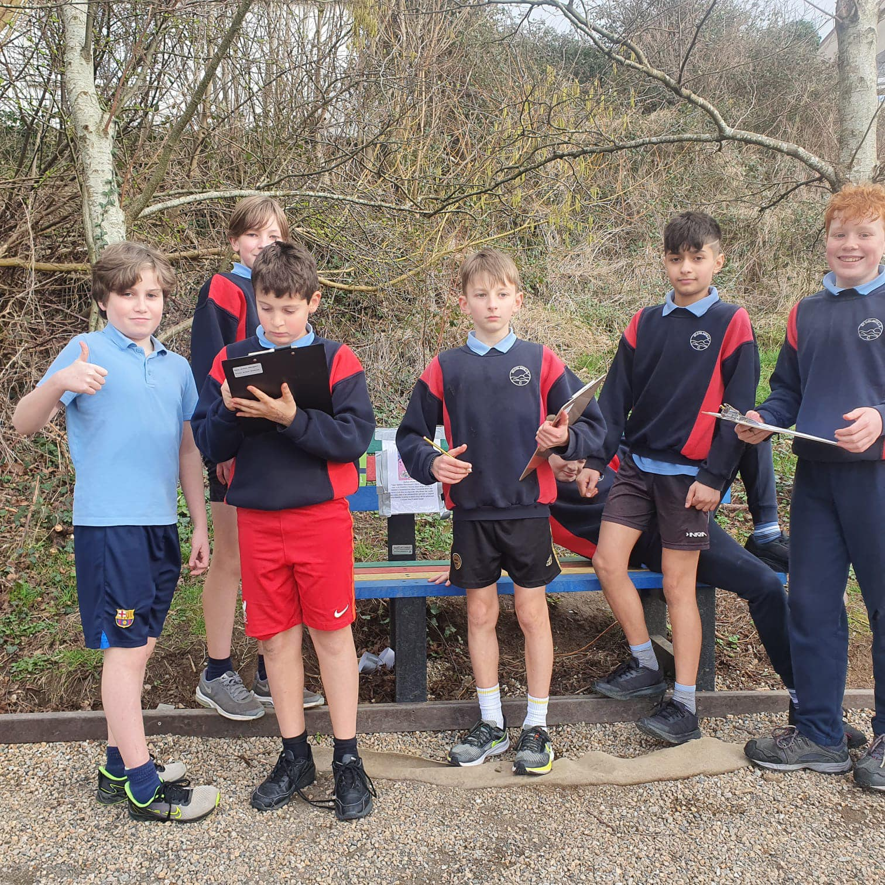
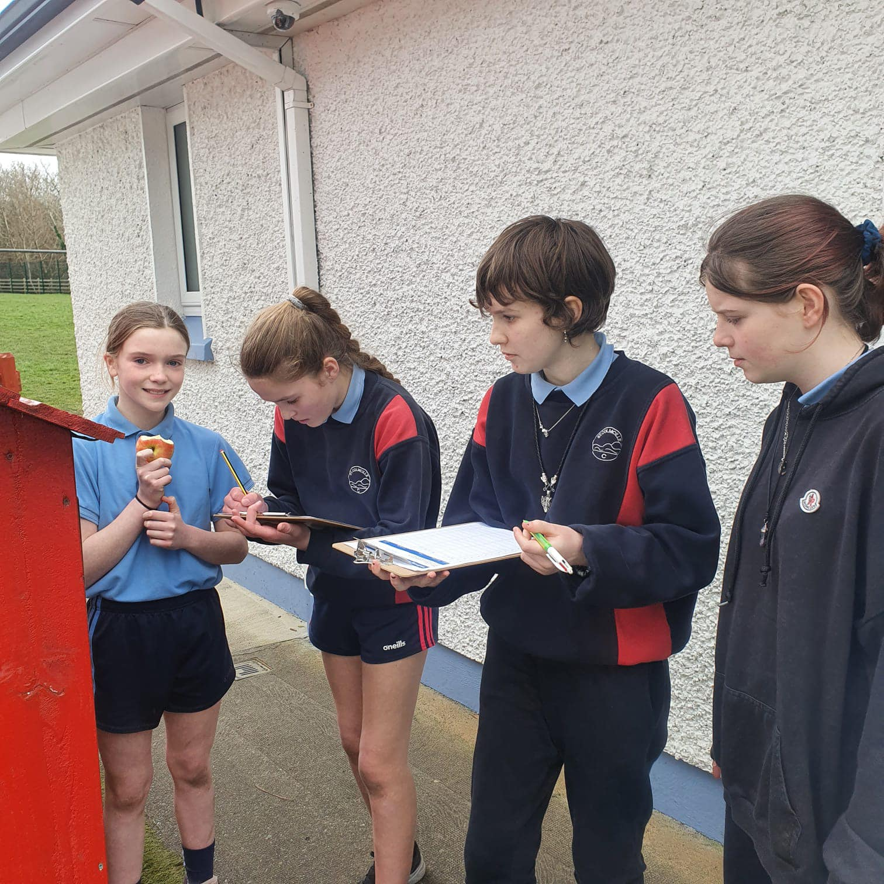
WALKWAY Challenges
www.activeschoolflag.ie
Notes:
Please provide evidence that all classes completed Walkway challenges during #ASW

Slide 4
Whole School FUN Event
Active Schools Week 2022 | Monday | Tuesday | Wednesday | Thursday | Friday
9.00 | Hula Fun – 6th B Forde Fitness – 6th A | Basketball 6th B A.S. Walkway 6th A | ***5th & 6th on Tour | Golf 6th B Pickleball 6th A | Sports Day!
9.30 | Hula Fun – S.I. Forde Fitness – 5th | Basketball S.I. A.S. Walkway 5th | Yoga 1^{st (Hall)} Tennis J.I. | Golf S.I Pickleball 5th
10.00 | Hula Fun – 1st Forde Fitness – J.I. | Basketball 1st A.S. Walkway J.I. | Yoga 4^{th(Hall)} Tennis S.I. | Golf 1st Pickleball J.I.
11.00 | Hula Fun – 2nd/3rd Forde Fitness – 1st | Basketball 2nd/3rd A.S. Walkway 1st | Yoga J.I.(Hall) Tennis 1st | Golf 2nd/3rd Pickleball 1st
11.30 | Hula Fun – J.I. Forde Fitness – S.I. | Basketball J.I. A.S. Walkway S.I. | Yoga S.I. (Hall) Tennis 2nd/3rd | Golf J.I. Pickleball S.I.
1.00 | Hula Fun – 4th Forde Fitness – 2nd/3rd | Basketball 4th A.S. Walkway 2nd/3rd | Yoga 2nd/3^{rd (Hall)} Tennis 4th*12pm | Golf 4th Pickleball 2nd/3rd
1.30 | Hula Fun – 6th A Forde Fitness – 6th B | Basketball 6th A A.S. Walkway 6th B |  | Golf 6th A Pickleball 6th B
2.00 | Hula Fun – 5th Forde Fitness – 4th | Basketball 5th A.S. Walkway 4th |  | Golf 5th Pickleball 4th
www.activeschoolflag.ie
Notes:
Please provide evidence that your school organised a whole school FUN event as part of #ASW

Slide 5
#ASW Week Timetable 2022
Active Schools Week 2022 | Monday | Tuesday | Wednesday | Thursday | Friday
9.00 | Hula Fun – 6th B Forde Fitness – 6th A | Basketball 6th B A.S. Walkway 6th A | ***5th & 6th on Tour | Golf 6th B Pickleball 6th A | Sports Day!
9.30 | Hula Fun – S.I. Forde Fitness – 5th | Basketball S.I. A.S. Walkway 5th | Yoga 1^{st (Hall)} Tennis J.I. | Golf S.I Pickleball 5th
10.00 | Hula Fun – 1st Forde Fitness – J.I. | Basketball 1st A.S. Walkway J.I. | Yoga 4^{th(Hall)} Tennis S.I. | Golf 1st Pickleball J.I.
11.00 | Hula Fun – 2nd/3rd Forde Fitness – 1st | Basketball 2nd/3rd A.S. Walkway 1st | Yoga J.I.(Hall) Tennis 1st | Golf 2nd/3rd Pickleball 1st
11.30 | Hula Fun – J.I. Forde Fitness – S.I. | Basketball J.I. A.S. Walkway S.I. | Yoga S.I. (Hall) Tennis 2nd/3rd | Golf J.I. Pickleball S.I.
1.00 | Hula Fun – 4th Forde Fitness – 2nd/3rd | Basketball 4th A.S. Walkway 2nd/3rd | Yoga 2nd/3^{rd (Hall)} Tennis 4th*12pm | Golf 4th Pickleball 2nd/3rd
1.30 | Hula Fun – 6th A Forde Fitness – 6th B | Basketball 6th A A.S. Walkway 6th B |  | Golf 6th A Pickleball 6th B
2.00 | Hula Fun – 5th Forde Fitness – 4th | Basketball 5th A.S. Walkway 4th |  | Golf 5th Pickleball 4th
www.activeschoolflag.ie
Notes:
Please provide evidence that your school organised Teacher Challenges as part of #ASW

Slide 6
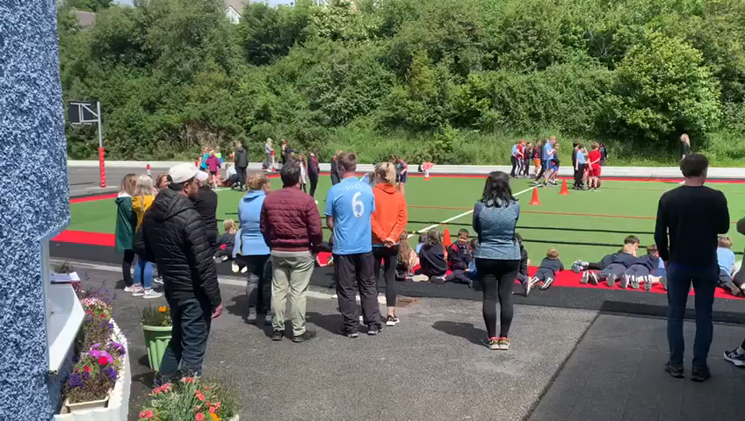
Pupil Challenge
www.activeschoolflag.ie
Notes:
Please provide evidence that your school organised a Teachers vs. Pupils challenge as part of #ASW

Slide 7
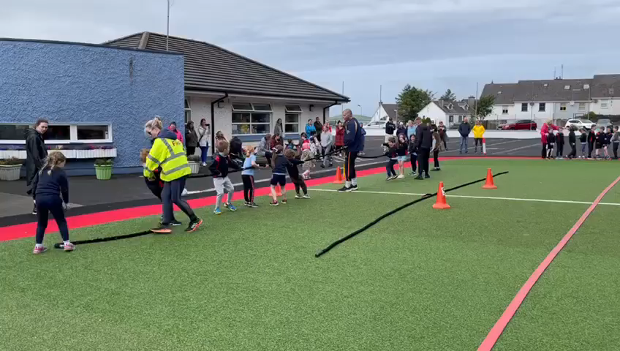
Trying NEW Activities
www.activeschoolflag.ie
Notes:
Please provide evidence that your school introduced children to NEW activities as part of #ASW

